Slide 1

Usage Funnels: Warby
Parker
Creating purchase funnels with SQL
Parshva Jhaveri
Date: 20-01-2025

Slide 2
Table of Contents
INTRODUCTION
FUNNELS
CONCLUSION

Slide 3
1. Introduction

Slide 4
1.1 Introduction and context
Warby Parker is a transformative lifestyle brand with a lofty objective: to offer designer eyewear at a revolutionary price while leading the way for socially conscious businesses.
The data is fictional but closely resembles real world data.
In this project, we build multiple funnels- the quiz funnel, purchase funnel and home-try on funnels.
Relevant tables for each funnel are given below.
Quiz Funnel | Home Try On Funnel
Survey | Quiz
 | Home_try_on
 | purchase

Slide 5
1.2. Database Schema
survey- question, user_id, response
quiz-user_id, style,fit,shape,color
home_try_on-user_id, number_of_pairs, address
purchase-user_id,product_id, style, model_name, color, price

Slide 6
1.3. Funnel context
Warby Parker’s purchase funnel is:
Take the Style Quiz → Home Try-On → Purchase the Perfect Pair of Glasses
During the Home Try-On stage, we will be conducting an A/B Test:
50% of the users will get 3 pairs to try on
50% of the users will get 5 pairs to try on

Slide 7
2. Funnels

Slide 8
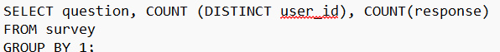
2.1 Creating the quiz funnel
The given SQL query shows us how many users answered each question in the quiz.
Users mainly drop off at question 3 and question 5.
question | COUNT (DISTINCT user_id) | COUNT(response) | PERCENTAGE_RESPONSES
1. What are you looking for? | 500 | 500 | 100%
2. What's your fit? | 475 | 475 | 95%
3. Which shapes do you like? | 380 | 380 | 80%
4. Which colors do you like? | 361 | 361 | 95%
5. When was your last eye exam? | 270 | 270 | 75%

Slide 9
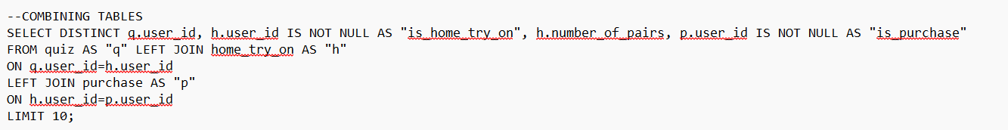
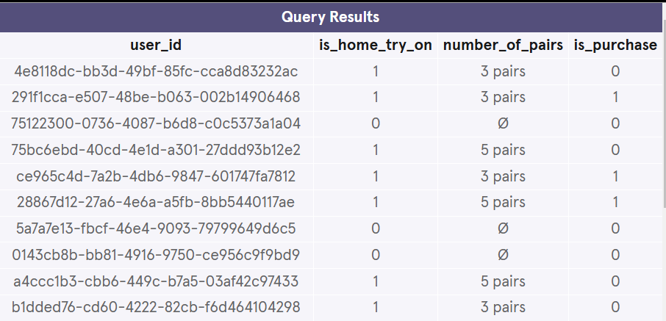
2.2. Combining tables
To create a conversion funnel, we need to combine multiple tables- quiz, home_try_on and purchase.

Slide 10
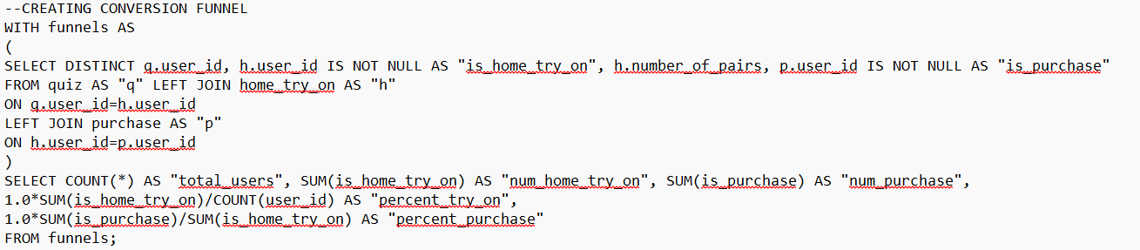
2.3. Creating Conversion funnel
Using the query in 2.1. as “funnels”, we create a single table with all the data we require to calculate conversion rate.
This combined table is used to calculate overall conversion rate.
total_users | num_home_try_on | num_purchase | percent_try_on | percent_purchase
1000 | 750 | 495 | 0.75 | 0.66

Slide 11
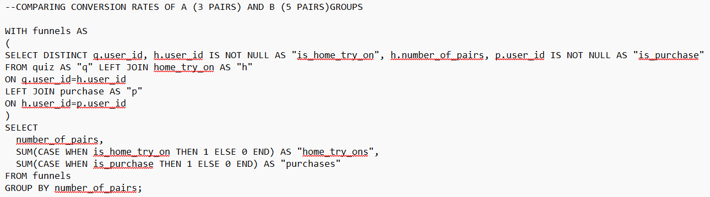
2.3. Comparing Conversion of A/B Test
During the home try on phase, half the users were given 3 pairs and the other half were given 5 pairs.
number_of_pairs | home_try_ons | purchases | conversion_rate
3 pairs | 379 | 201 | 53%
5 pairs | 371 | 294 | 79%

Slide 12
Conclusion
The group given 5 pairs to try on at home resulted in a significantly higher conversion rate.
Using funnels, we were able to identify drop off points in the customer survey.

